Slide 1
Rain in Seattle
Dan Siegel
DSC530-T301 Data Exploration and Analysis (2187-1)
Bellevue University

Slide 2
Why are we here?
Hypothesis :Rain has been steadily increasing in Seattle.
Null Hypothesis: Rain has not increased or changed over time
The hypothesis turned out to be wrong, but I did find that temperatures have been increasing steadily in Seattle, and let’s review how I got there

Slide 3
The Variables of Seattle Rain
DATE: the date of the observation
PRCP: the amount of precipitation, in inches
TMAX: the maximum temperature for that day, in degrees Fahrenheit
TMIN: the minimum temperature for that day, in degrees Fahrenheit
RAIN: TRUE if rain was observed on that day, FALSE if it was not

Slide 4
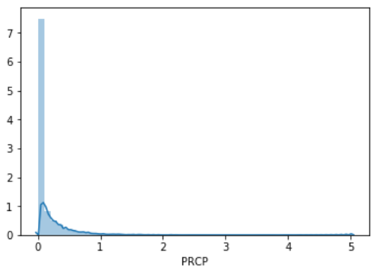
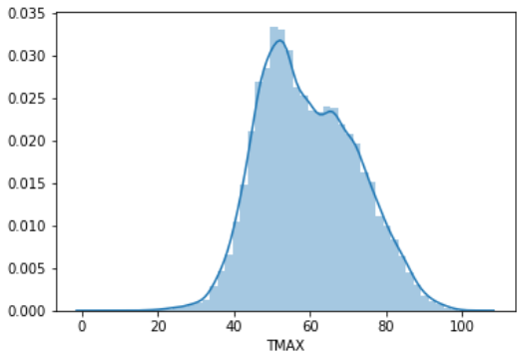
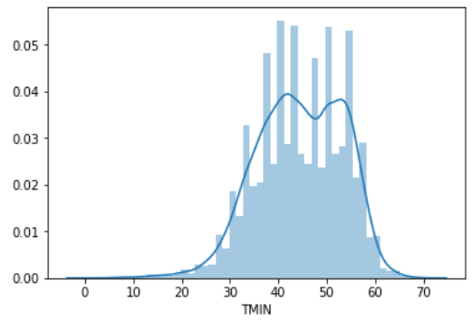
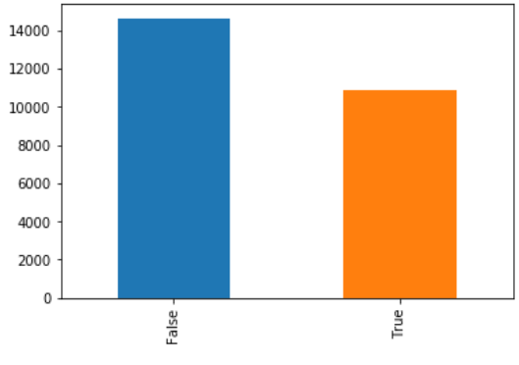
Histograms of the data
Rain

Slide 5
Descriptive Characteristics: mean, median, mode, standard dev
PRCP
Mean: 0.11
Median: 0.0
Mode: 0 0.0
Std: 0.24
Range: 5.02, 0.0
TMAX:
Mean: 59.54
Median: 58.0
Mode: 0 50
Std: 12.77
Range: 103, 4
TMIN:
Mean: 44.51
Median: 45.0
Mode: 0 42
Std: 8.89
Range: 71, 0
Rain:
Mean: 0.43
Median: 0
Std: .50
Range: N/A, Boolean value
Date
Range 1/1/1948-12/14/2017

Slide 6
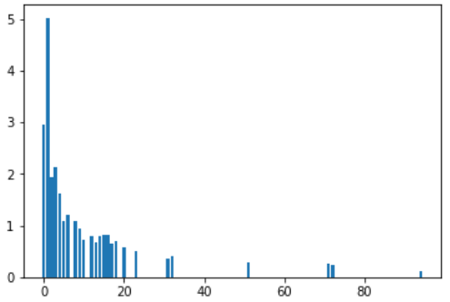
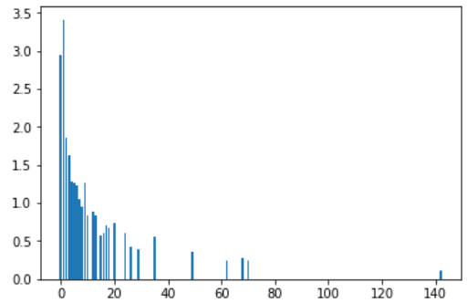
Compare Two Scenarios with PMF
PMF of Precipitation
This tells us the frequency of higher rain is lower in the second half, but instances of lower rain are more frequent
1948 - 1982
1982 - 2017

Slide 7
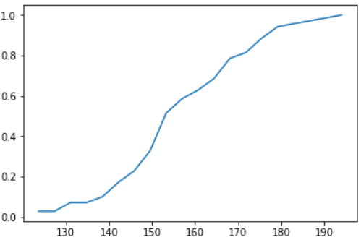
Create 1 CDF
Here I have plotted the CDF of the amount of rain per year. The curve tells us that we’re not seeing extreme values in the data, as we’d expect if the number of days it rains in Seattle were increasing per year

Slide 8
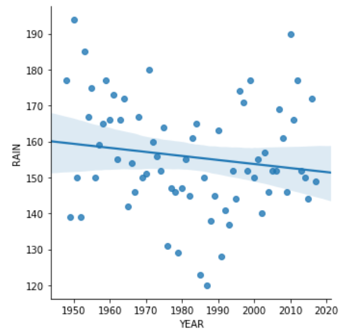
Plot 1 analytical distribution
This is the plot of number of times it rains per year fitted with a linear regression line. We can see there’s a wide range in where it goes, but unfortunately for my poor hypothesis, the data does not agree with it.

Slide 9
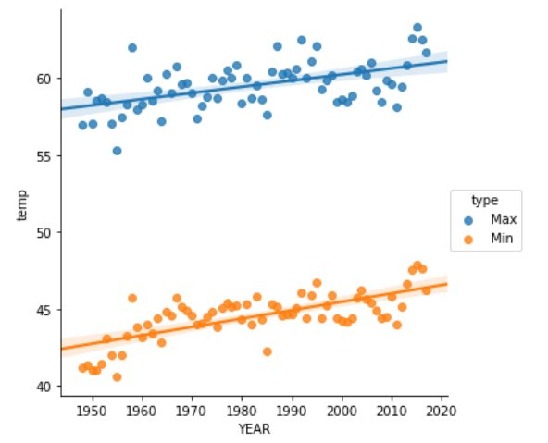
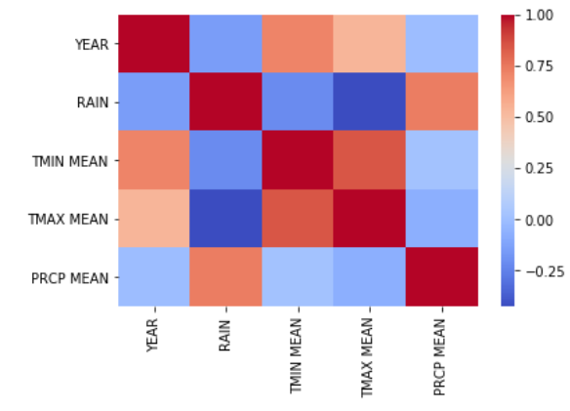
Create two scatter plots comparing two variables
This is comparing the min and maximum temperatures. In the correlation heat map we can see a high correlation between the min and max as well. Since temperatures are connected, it makes sense that those two variables have a relationship of causation not just correlation.

Slide 10
P Test
result = sm.ols(formula='RAIN ~ YEAR',data=rain_per_year).fit()
result.pvalues
Pvalues of the intercept are 0.039904, and close but not statistically significant.

